Slide 1
Breast Cancer Analysis INFO 7390 Advances in Data Science/Architecture
Team Data Alchemists:
Yash Wadhwa :002778382
Makarand Zende :002772931
Arpita Bhagat :002776356
Samradni Pathari :002655149

Slide 2
INTRODUCTION
Breast cancer is leading cancer affection women globally
Early detection and accurate diagnosis are crucial.
Can improve treatment outcomes and reducing mortality rates associated with breast cancer.
Maintained strict data integrity and security throughout analysis and modeling phases.

Slide 3
AIM
OBJECTIVE: EXPLORE FEATURE RELATIONSHIPS TO CLASSIFY BREAST TUMORS AS BENIGN OR MALIGNANT.
METHODS: USE DATA ANALYSIS AND MACHINE LEARNING TO ENHANCE EARLY DETECTION AND PERSONALIZE TREATMENT.
IMPACT: DRIVE IMPACTFUL HEALTHCARE ADVANCES WITH BREAST CANCER DATA INSIGHTS.

Slide 4
DATASET OVERVIEW
ID: Unique identifier for each biopsy sample.
Diagnosis: The diagnosis of breast tissues (M = malignant, B = benign).
Radius_mean: Mean of distances from center to points on the perimeter.
Texture_mean: Standard deviation of gray-scale values.
Perimeter_mean: Mean size of the core tumor.
Area_mean: Mean area of the core tumor.
Smoothness_mean: Mean of local variation in radius lengths.
Compactness_mean: Mean of perimeter^2 / area - 1.0.
Concavity_mean: Mean severity of concave portions of the contour.
Concave_points_mean: Mean number of concave portions of the contour.
Symmetry_mean: Mean symmetry of tumor.
Fractal_dimension_mean: Mean "coastline approximation" - 1.

Slide 5
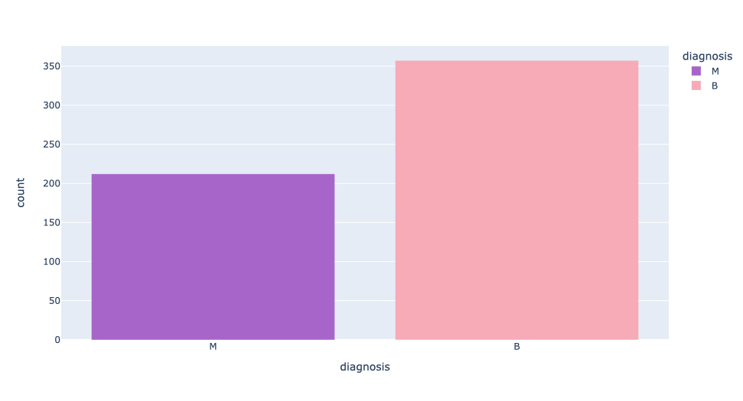
BREAST CANCER DIAGNOSIS DISTRIBUTION

Slide 6
ALGORITHMS USED
Logistic Regression
Decision Tree
K-Nearest Neighbors
Random Forest Classifier
XG Boost
Naive Bayes

Slide 7
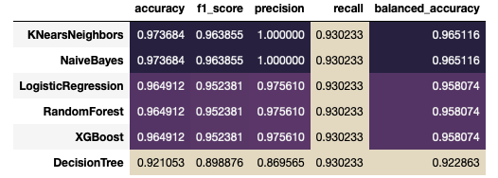
MACHINE LEARNING MODELS METRICS

Slide 8
CONCLUSION
OUR BEST PERFORMING MODELS ON THE BREAST CANCER DATASET ARE: NAIVE BAYES AND K-NEAREST NEIGHBORS (KNN).
FROM THE EMPLOYED LIST OF ALGORITHMS, NAIVE BAYES AND K-NEAREST NEIGHBORS (KNN) SHOWED THE TOP PERFORMANCE WITH THE FOLLOWING METRICS:
Naive Bayes – Balanced Accuracy: 96.51% | f1 Score: 96.38%
K-Nearest Neighbors (KNN) – Balanced Accuracy: 96.51% | f1 Score: 96.38%

Slide 9
Thank You !

